Slide 1
Storytelling with Data: Model Curricula Focusing on Input, Processing and Output
Lindita Camaj
Associate professor

Slide 2
Content
Introduction to Data Storytelling
Research and Teaching Big Data in Academic Institutions
Model Curricula in Data Storytelling
Processes in Data Storytelling

Slide 3
Introduction
The aim of this presentation is to provide a starting place for introducing data storytelling into higher education curricula
Data-driven storytelling is a field that encompasses a suite of practices for collecting, analyzing, visualizing and publishing data for storytelling purposes
It reflects the increased role of the use of numerical data in the production and distribution of information in a digital era.
It reflects the increased interaction between content producers and several other fields such as design, computer science and statistics.
COMM 3313: Data Journalism, Valenti School of Communication

Slide 4
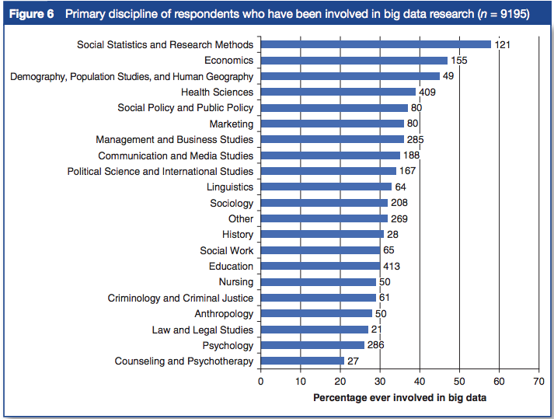
Big Data Research in Social Sciences
Country N=35
Source: Metzler, K., Kim, D., Allum, N., & Denman, A. (2016). Who is Doing Computational Social Science? Trends in Big Data research. London, UK: Sage Publishing. doi: 10.4135/wp160926
Notes:
Computational work in the humanities and social sciences is growing. The use of data and computation in architecture, geography and economics reflects how these disciplines adopted new tools and methods in recent decades.

Slide 5
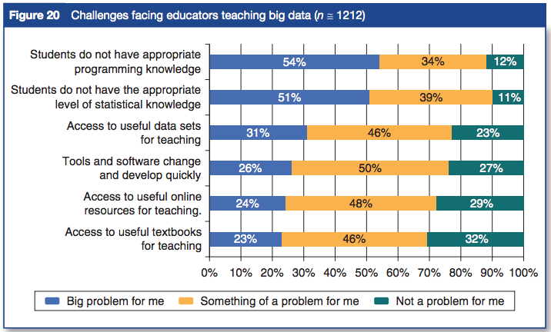
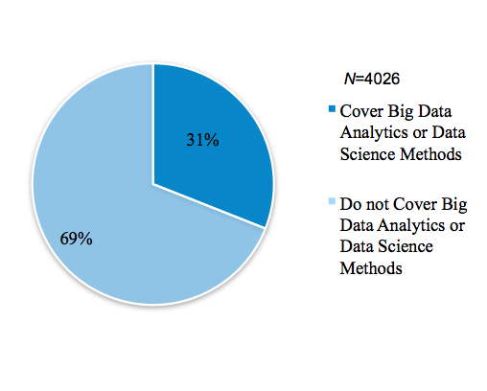
Teaching Big Data in Social Sciences
Source: Metzler, K., Kim, D., Allum, N., & Denman, A. (2016). Who is Doing Computational Social Science? Trends in Big Data research. London, UK: Sage Publishing. doi: 10.4135/wp160926

Slide 6
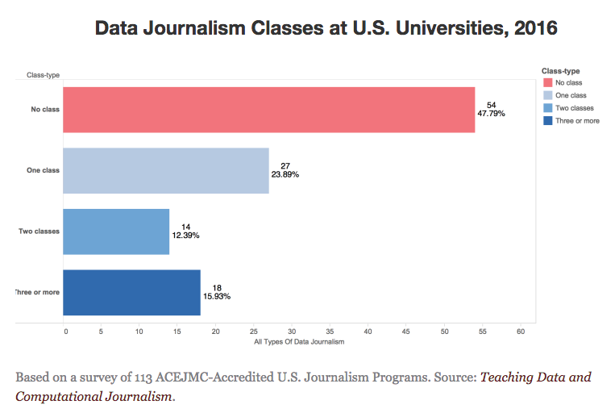
Berret & Phillips, 2016

Slide 7
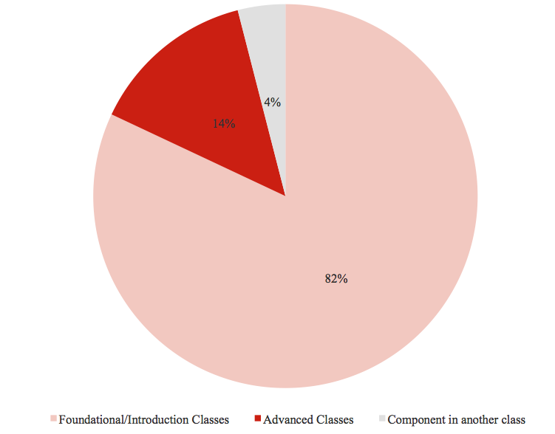
Types of Classes in Data Storytelling
Berret & Phillips, 2016

Slide 8
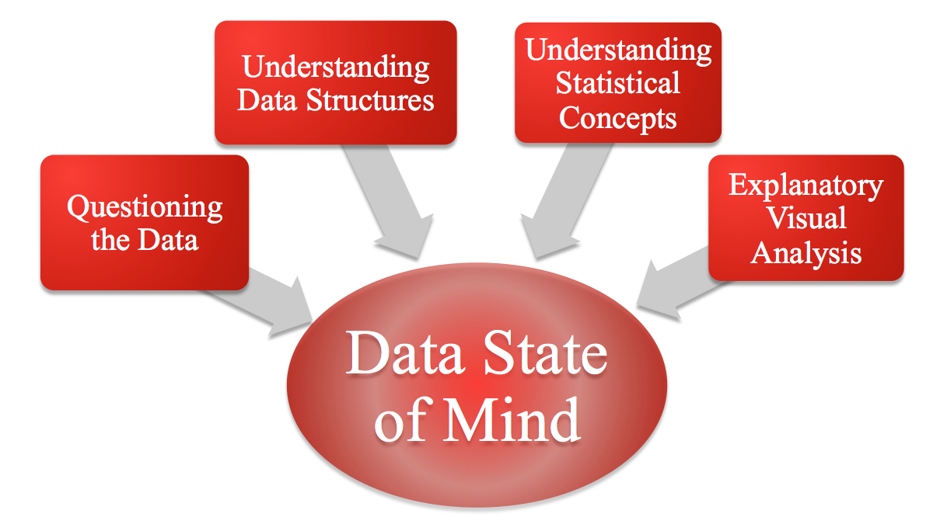
Fundamental Data Skills

Slide 9
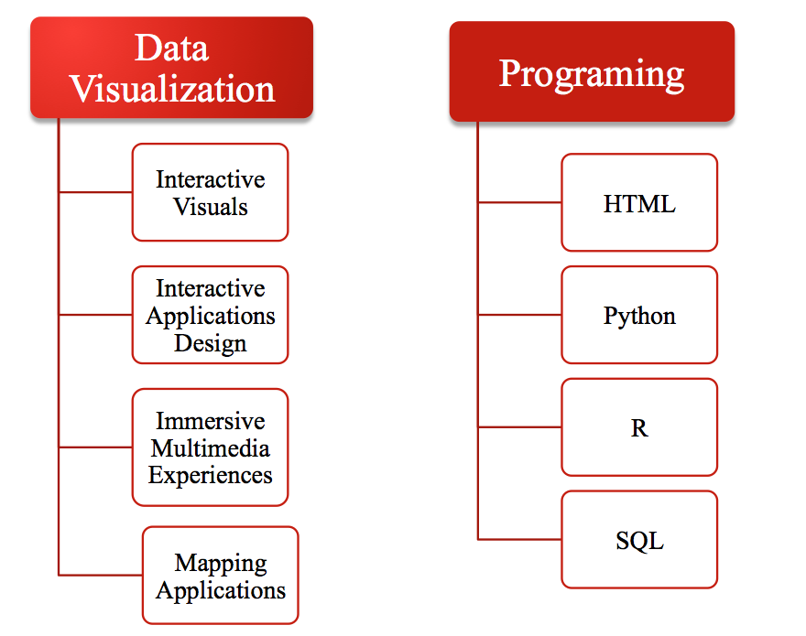
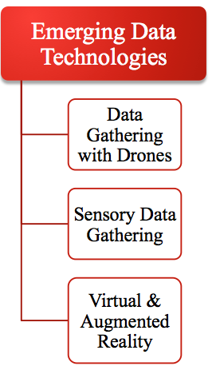
Advanced Data Skills

Slide 10
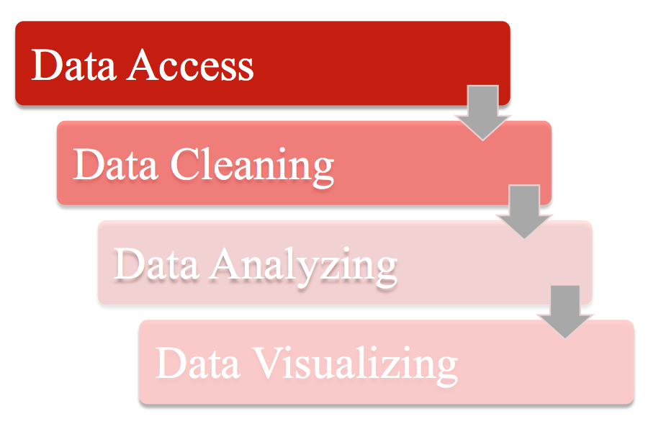
Data Storytelling Processes

Slide 11
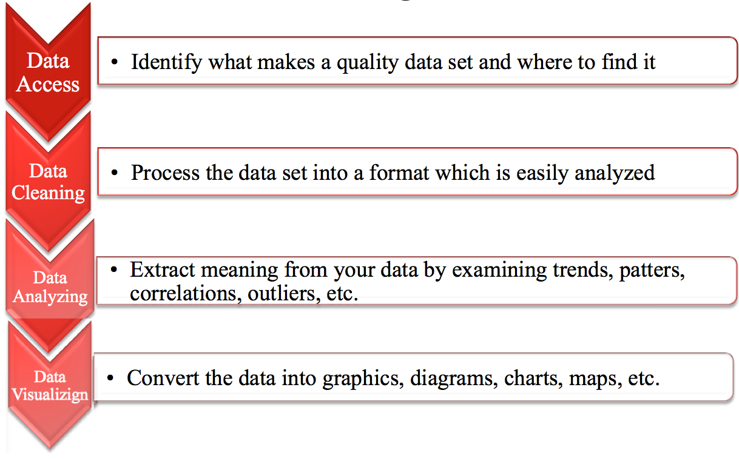
Data Storytelling Processes

Slide 12
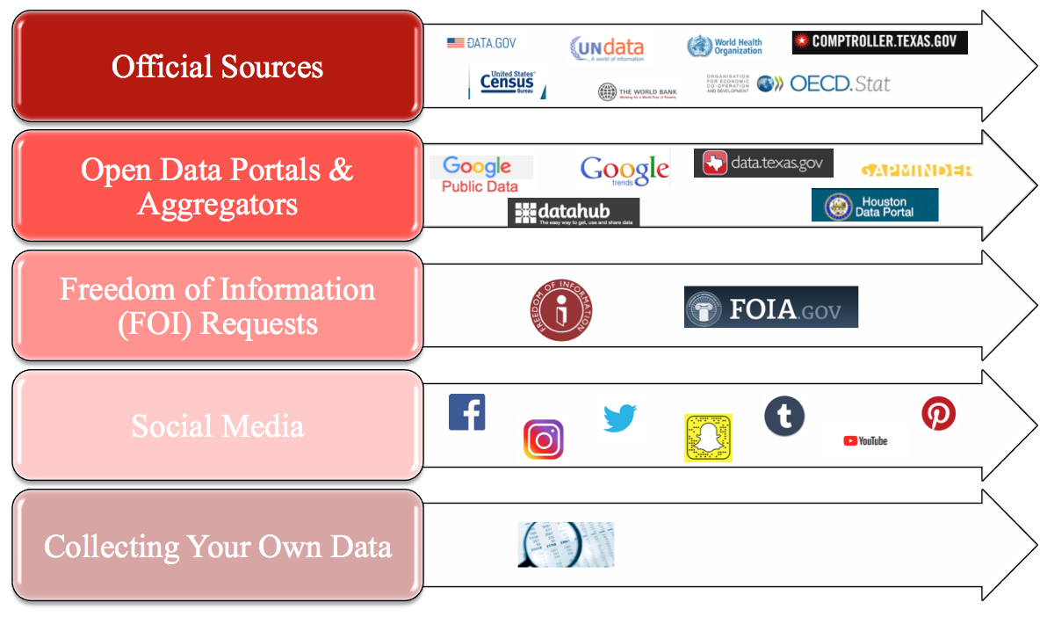
Data Sources

Slide 13
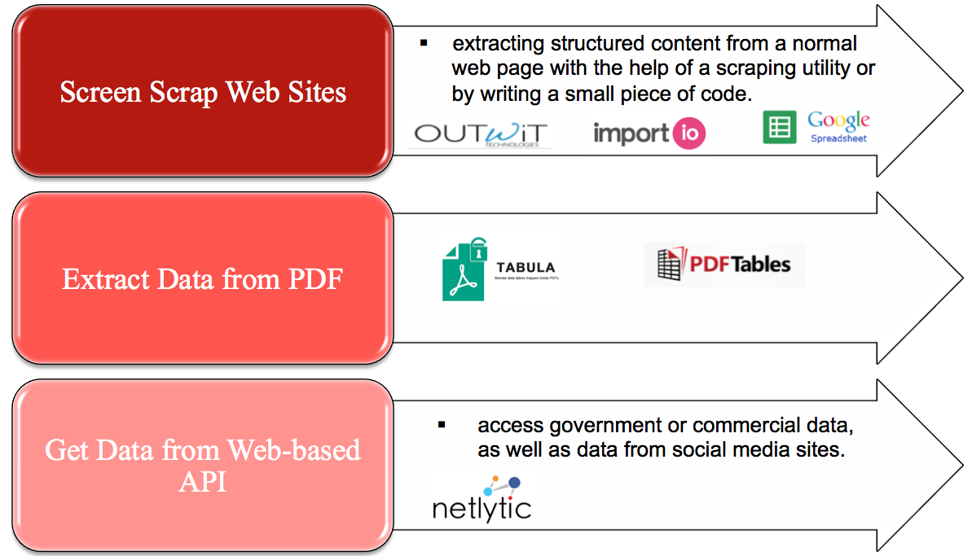
Data Access/Scrapping

Slide 14
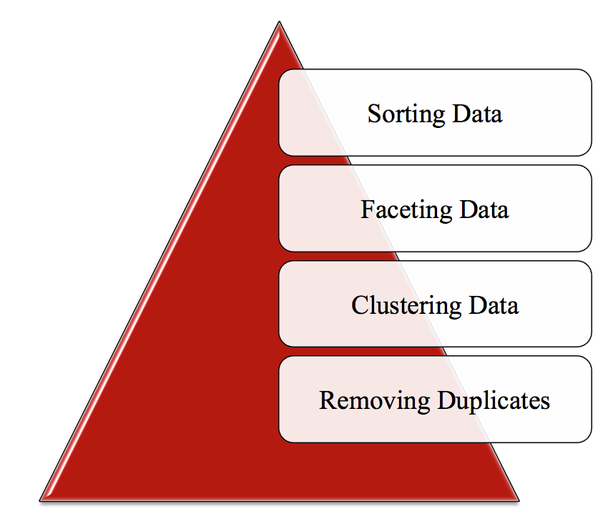
Data Cleaning

Slide 15
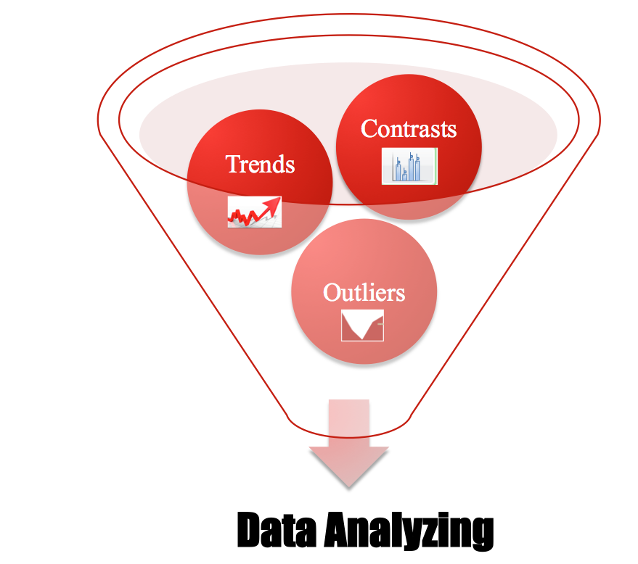

Slide 16
Basic Math Functions
Percentage
Rates
Simple Statistics:
Sum
Average
Median
Mode
Outliers
Multivariate Statistics
Correlations
Regressions

Slide 17
Tools for Data Analyzing

Slide 18
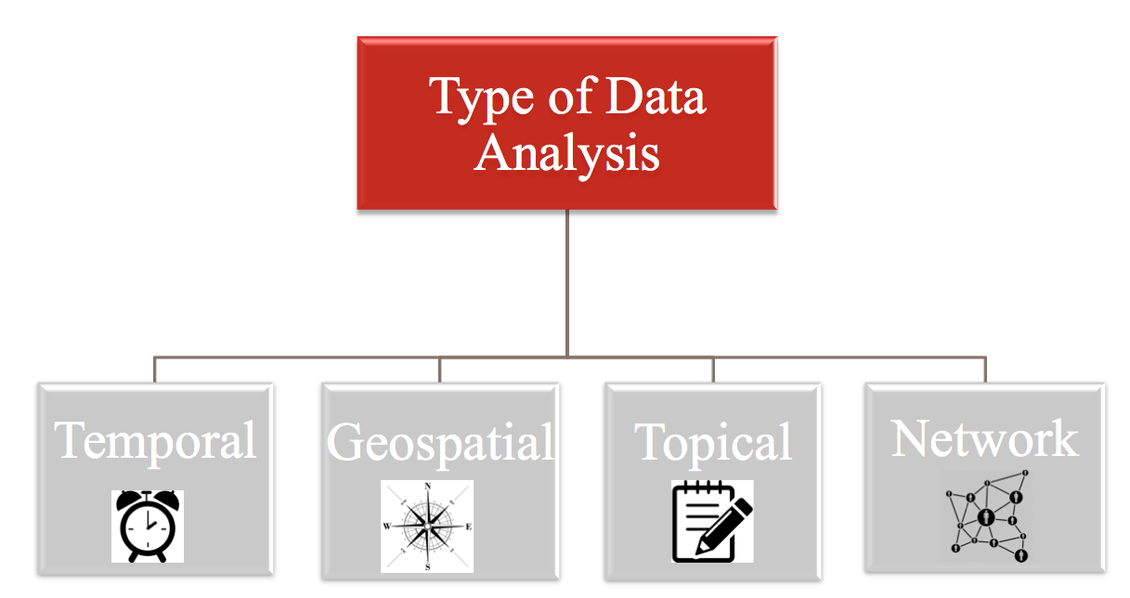
Data Visualization

Slide 19
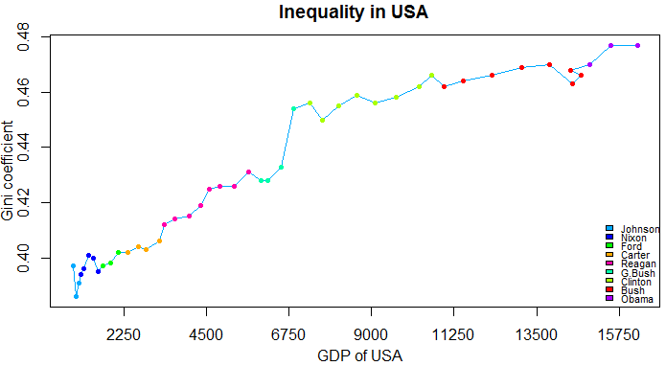
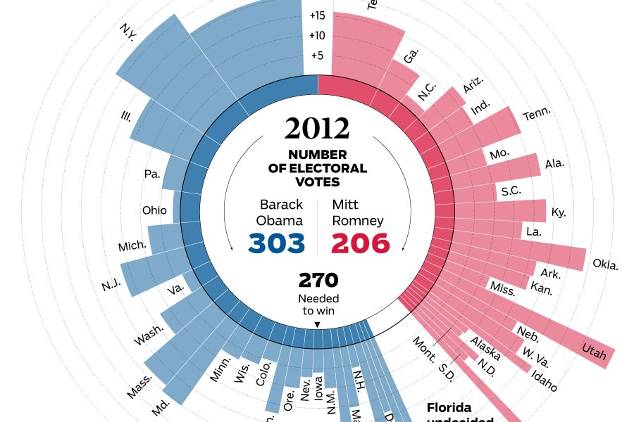
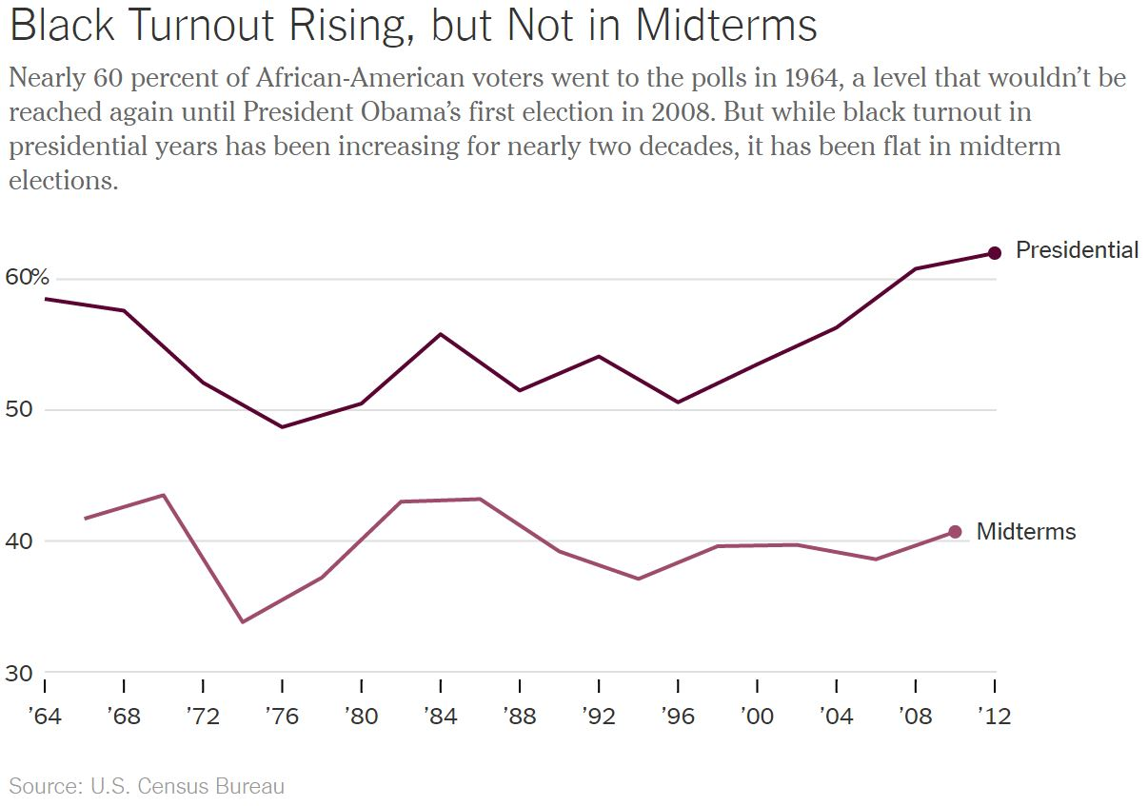
Temporal – one-dimensional linear visualization
Connected Scatter Plot: A connected scatter plot is a plot that displays values of two variables for a set of data, with an added line that connects the data series.
Polar Area Diagram: A polar area diagram is similar to a traditional pie chart, but sectors differ in how far they extend from the center of the circle rather than by the size of their angles.
Time Series: A time series is a sequence of data points typically consisting of successive measurements made over a time interval, such as the number of website visits over a period of several months.

Slide 20
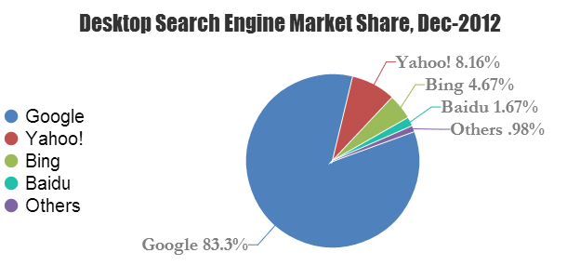
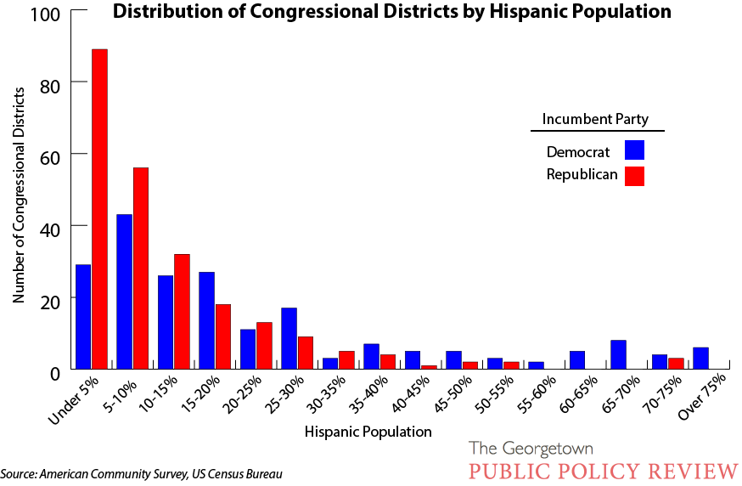
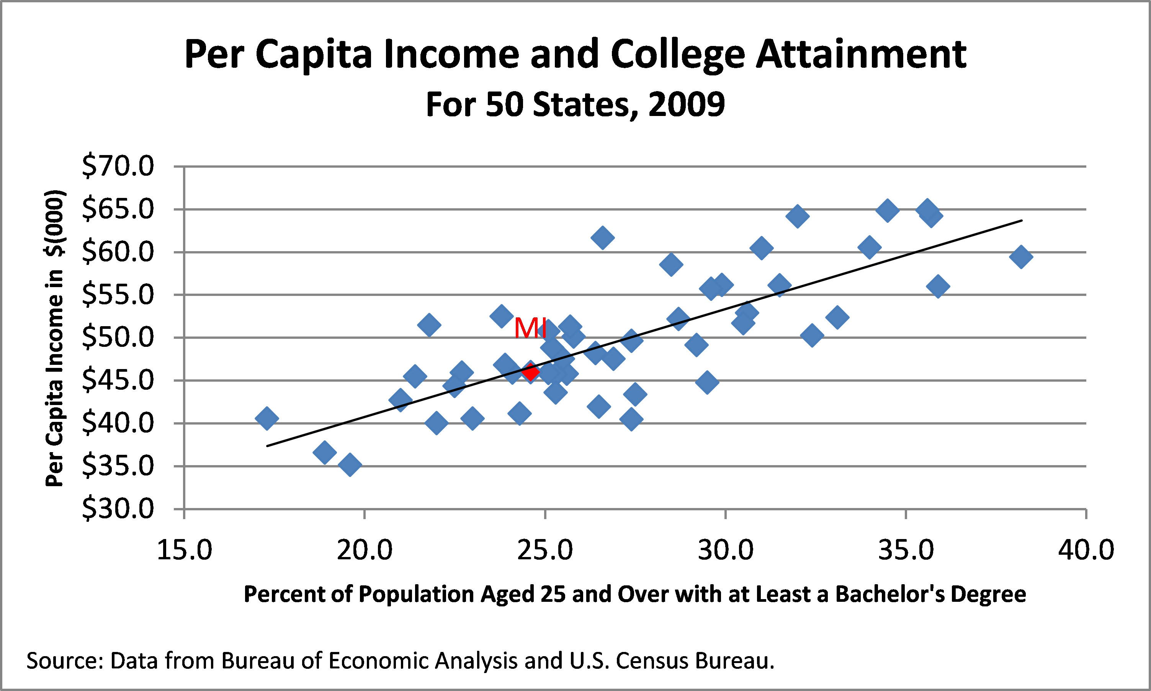
Multidimensional visualizations
Pie Chart: A pie or circle chart is divided into sectors to illustrate numerical proportion; the arc length and angle of each sector is proportional to the quantity it represents.
Histogram: A histogram is a data visualization that uses rectangles with heights proportional to the count and widths equal to the “bin size” or range of small intervals.
Scatter Plot: A scatter plot displays values for two variables for a set of data as a collection of points.

Slide 21
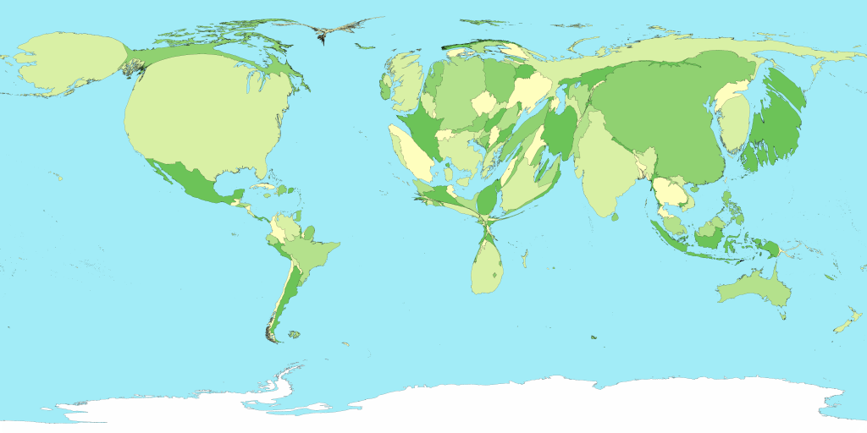
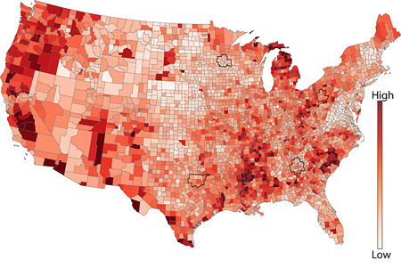
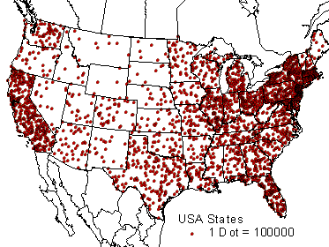
Geospatial – 2D mapping
Cartogram: A cartogram distorts the geometry or space of a map to convey the information of an alternative variable, such as population or travel time. The two main types are area and distance cartograms.
Choropleth: A choropleth is a map with areas patterned or shaded to represent the measurement of a statistical variable, such as most visited website per country or population density by state.
Dot Distribution Map: A dot distribution or dot density map uses a dot symbol to show the presence of a feature on a map, relying on visual scatter to show spatial pattern.

Slide 22
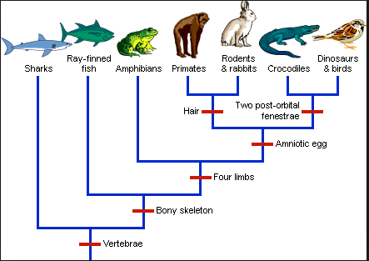
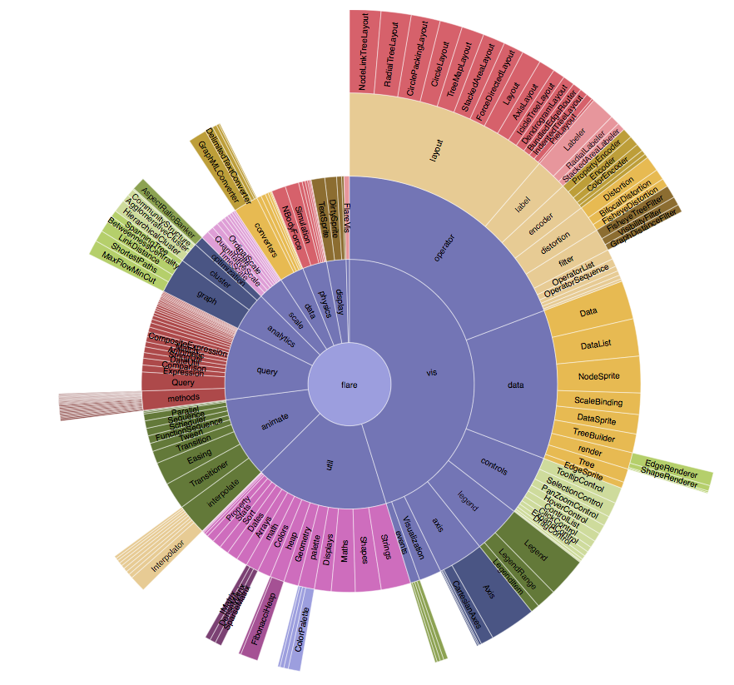
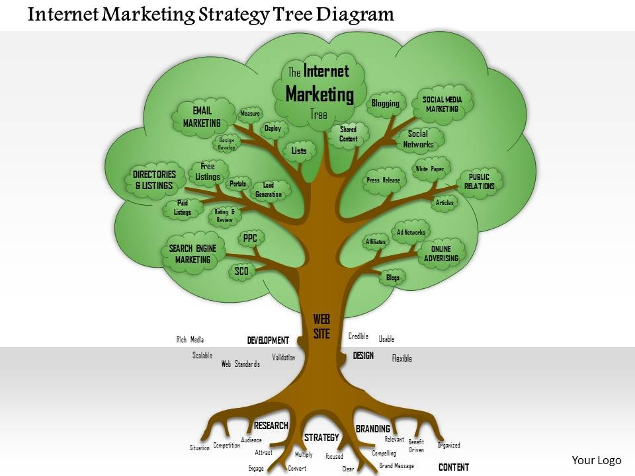
Hierarchical Visualization
Dendrogram: A dendrogram is a tree diagram used to illustrate an arrangement of clusters produced by hierarchical clustering.
Ring Chart: A ring or sunburst chart is a multilevel pie chart that visualizes hierarchical data with concentric circles.
Tree Diagram: A tree diagram or tree structure represents the hierarchical nature of a structure in graph form. It can be visually represented from top to bottom or left to right.

Slide 23
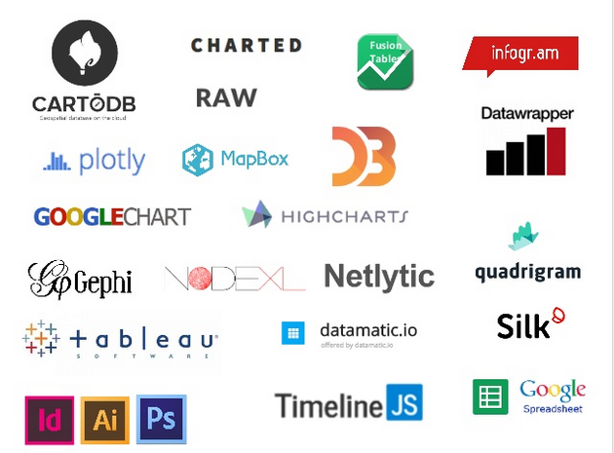
Data Visualization Tools

Slide 24
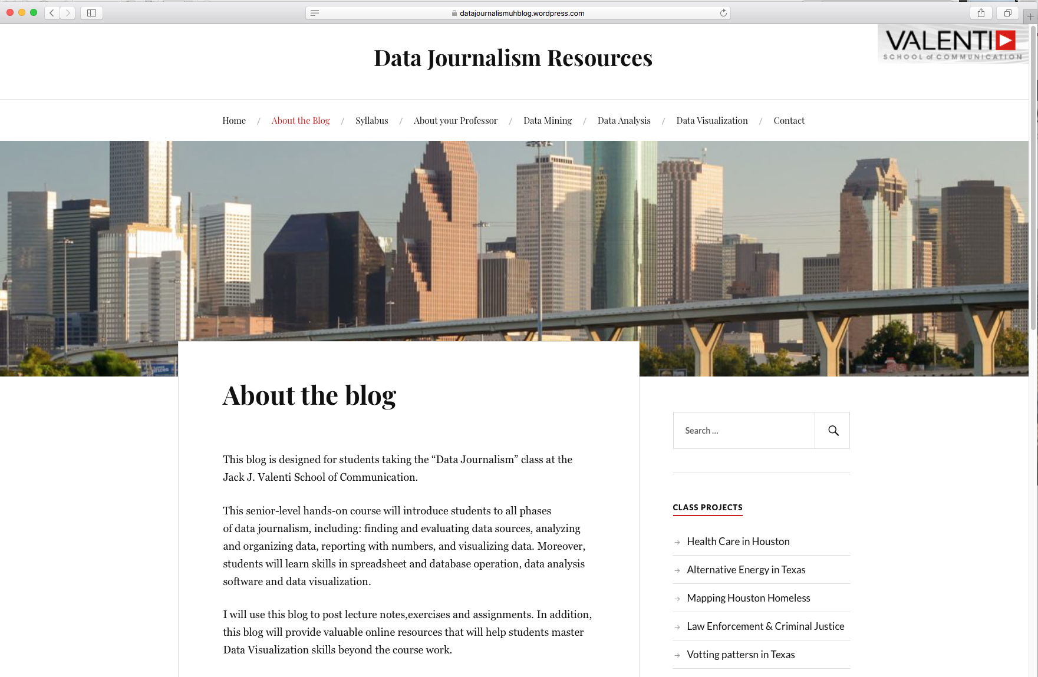
Visit my Data Journalism Blog
https://datajournalismuhblog.wordpress.com/

Slide 25
Thank You!
lcamaj@uh.edu
@camaj_camaj

