Slide 1
Research Focus of UH-DMML
Data Analysis
Geographical
Information Systems (GIS)
Machine
Learning
Data Mining
High Performance
Computing
Output: Graduated 12 PhD students and 80 Master Students
Christoph F. Eick

Slide 2
Research Areas
Clustering and Summary Generation
Spatial Data Mining and Analyzing Spatial Data
Association Analysis (Correlation Mining, Colocation Mining, Sequence Mining)
Helping Scientists to Understand and Summarize their Data
Classification and Prediction
UH-DMML

Slide 3
Characteristics of the Work We Do
One focus is on developing novel data mining (and other) algorithms and novel interestingness (and other) measures.
Other research centers on developing methods to make sense of data / to summarize data.
Application-driven approach: Find interesting and important datasets → develop frameworks and algorithms that produce “something useful” for those datasets
Some of our work is experimental in nature.
Occasionally, we try to solve theoretical problems, but this is not the main focus!
Work is kind of “hands on”.
Team work is encouraged.
UH-DMML

Slide 4
Current and Recent Research Projects
Mining POI Datasets
Patch-based Prediction Techniques
Doing Things With and For Polygons
Non-Traditional Clustering Algorithms
Collocation Mining
…
Christoph F. Eick

Slide 5
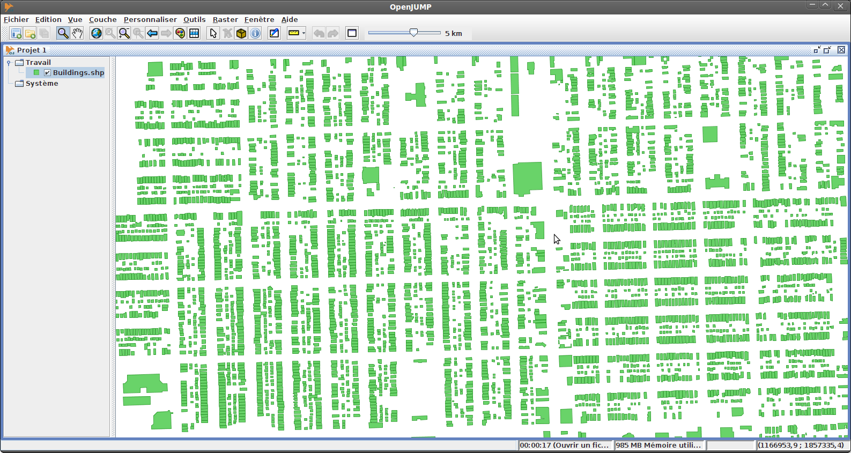
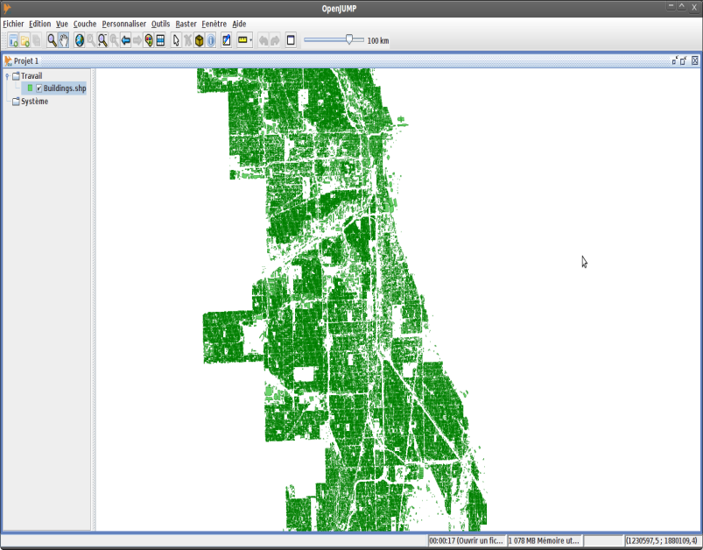
Mining POI Datasets
Motivation:
A lot of POI datasets (e.g. in Google Earth) are becoming available now.
http://bloomington.in.gov/documents/viewDocument.php?document_id=2455;dir=building/buildingfootprints/shape
https://data.cityofchicago.org/Buildings/Building-Footprints/w2v3-isjw
Buildings of the City of Chicago (830,000 Polygons) :
Challenges:
Extract Valuable Knowledge from such datasets→ Data Mining
Facilitate Querying and Visualizing of such dataset→ HPC / BigData Initiative

Slide 6
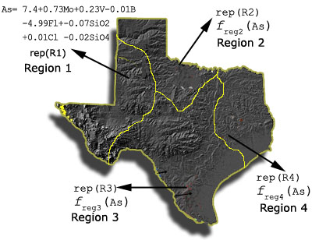
Patch-based Prediction Techniques
New Algorithms for Regression Tree Induction
New Decision Tree Induction Algorithms
Multi-Target Regression
Spatial Prediction Techniques
Ch. Eick

Slide 7
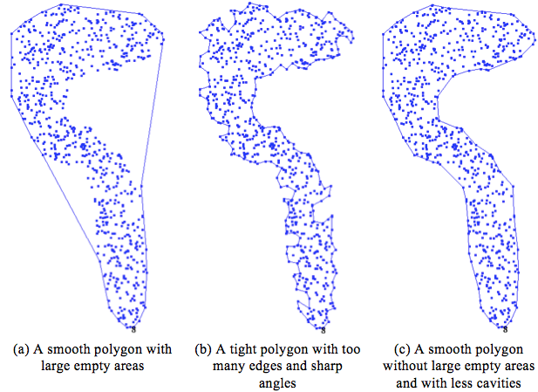
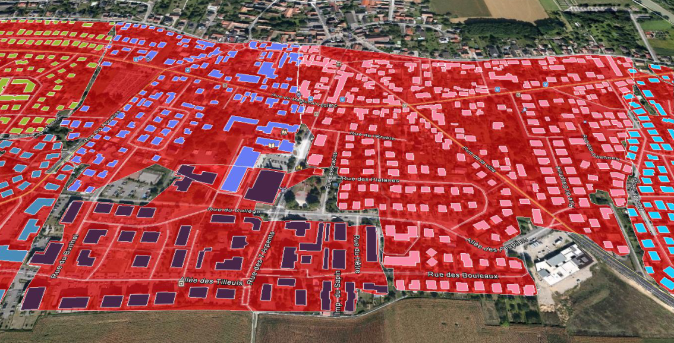
Doing Things With and For Polygons
Clustering Polygons
Using Polygons as Models for Spatial Clusters
Fitting Polygons to Points Clouds
Computing Boundaries Between Spatial Clusters
Measuring Emptiness in Polygons
UH-DMML

Slide 8
Non-Traditional Clustering Algorithms
Clustering Algorithms
With plug-in Fitness Functions
Polygonal Clustering
and Clustering Polygons
Mining
Spatio-Temporal
Datasets
Agglomerative
Clustering and
Hotspot Discovery
Algorithms
Prototype-based
Clustering
Parallel Computing
Randomized Hill Climbing
With a Lot of Cores
UH-DMML

Slide 9
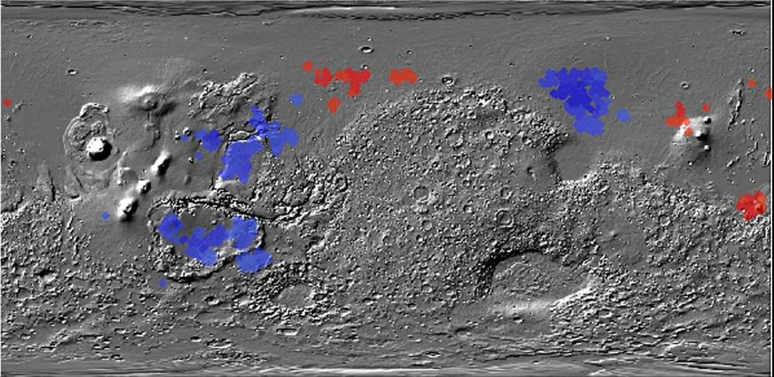
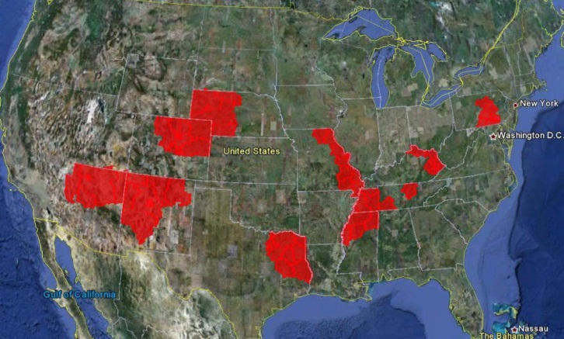
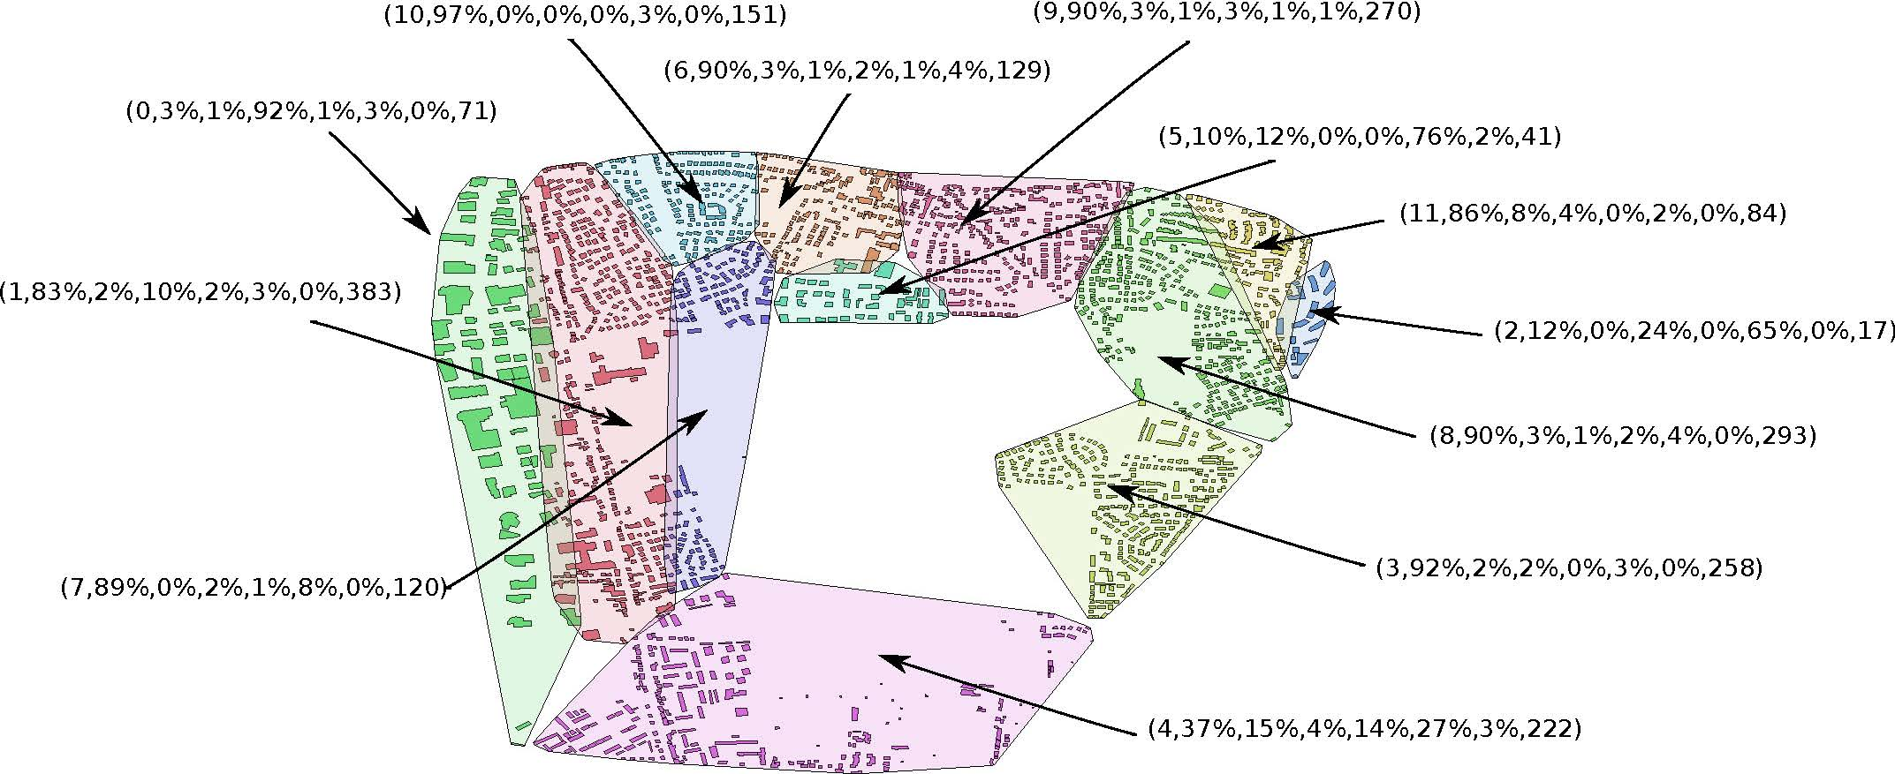
Helping Scientists to Make Sense Out of their Data
Figure 1: Co-location regions involving deep and
shallow ice on Mars
Figure 2: Interestingness hotspots where both income and CTR are high.
Figure 3: Analyzing the Composition of Cities
Ch. Eick

Slide 10
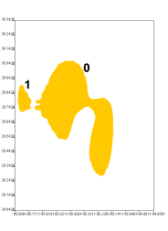
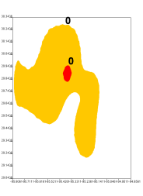
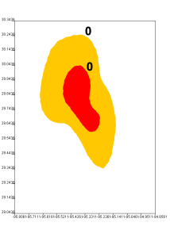
Potential “Future” Topics
Trajectory Classification and Prediction
Creating Parallel Versions of Clustering Algorithms
Models for the Evolution of Spatial Datasets
Urban Computing
Educational Data Mining
3p
5p
7p
?
Ozone Hotspot
Evolution

Slide 11
Some UH-DMML Graduates 1
Dr. Wei Ding, Assistant Professor Department of Computer Science, University of Massachusetts, Boston
Tae-wan Ryu, Professor,
Department of Computer Science, California State University, Fullerton
Sharon M. Tuttle, Professor,
Department of Computer Science,
Humboldt State University, Arcata, California
Christoph F. Eick

Slide 12
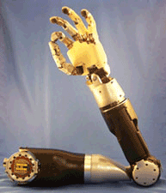
Some UH-DMML Graduates 2
Ruth Miller Ruth Miller, PhD Washington University in St. Louis, Postdoc - Midwest Alcohol Research Center, Department of Psychiatry. Adjunct Instructor - Department of Computer Science
Chun-sheng Chen, PhD Amazon, Seattle (analyzing web traffic)
Rachsuda Jiamthapthaksin PhD Lecturer Assumption University, Bangkok, Thailand
Justin Thomas MS Section Supervisor at Johns Hopkins University
Applied Physics Laboratory
Mei-kang Wu MS Microsoft, Bellevue, Washington
Jing Wang MS AOL, California
Christoph F. Eick

Slide 13
UH-DMML Mission Statement
The Data Mining and Machine Learning Group at the University of Houston aims
at the development of data analysis, data mining, and machine-learning techniques
and to apply those techniques to challenging problems in geology, astronomy, urban computing, ecology, environmental sciences, web advertising and medicine. In general, our research group has a strong background in the areas of clustering and spatial data mining. Areas of our current research include: clustering algorithms with plug-in fitness functions, association analysis, mining related spatial data sets, patch-based prediction techniques, summarizing the composition of spatial datasets, change and progression analysis, and data mining with a lot of cores.
Website: http://www2.cs.uh.edu/~UH-DMML/index.html
Research Group Publications: http://www2.cs.uh.edu/~ceick/pub.html
Data Mining Course Website: http://www2.cs.uh.edu/~ceick/DM/DM.html
Machine Learning Course Website: http://www2.cs.uh.edu/~ceick/ML/ML.html
Ch. Eick

Slide 14
Reading Material
Urban Computing/Spatial Clustering: SIGKDD Urban Computing Workshop 2013 Paper
Agglomerative Clustering: R. Jiamthapthaksin, C. F. Eick, and S. Lee, GAC-GEO: A Generic Agglomerative Clustering Framework for Geo-referenced Datasets, in Knowledge and Information Systems (KAIS).
Patch-based Prediction Techniques: MLDM 2013 Paper, ACM-GIS 2010 Paper
Data Mining with a lot of Cores: ParCo 2011 Paper
GIS/Creating Polygon Models: ACM-GIS 2013 Submission
Machine Learning Course Website: http://www2.cs.uh.edu/~ceick/ML/ML.html
Collocation Mining: ACM-GIS 2008 Paper
Spatial Clustering and Association Analysis: W. Ding, C. F. Eick, X. Yuan, J. Wang, and J.-P. Nicot, A Framework for Regional Association Rule Mining and Scoping in Spatial Datasets, Geoinformatica (2011) 15:1-28, DOI 10.1007/s10707-010-0111-6, January 2011.
Supervised Clustering: TAI 2005 Paper
Ch. Eick

Slide 15
What Courses Should You Take to Conduct Research in this Research Group?
Data Mining
Machine Learning
Parallel Programming, AI, Software Design, Data Structures, Databases, Big Data, Visualization, Evolutionary Computing, Image Processing, GIS courses, Geometry, Optimization.
UH-DMML

